Slide 1
GCP Ref Arch
By Altotech

Slide 2
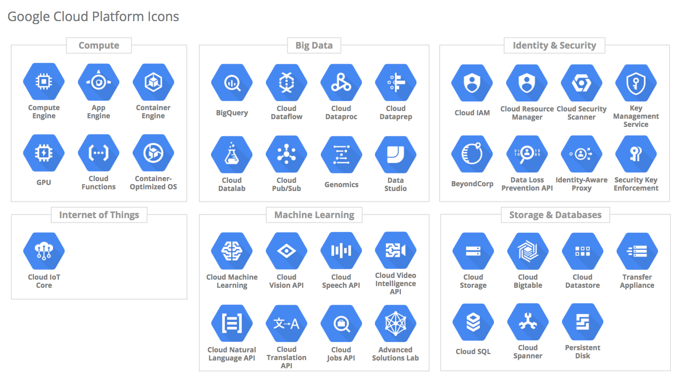

Slide 3
E-commerce

Slide 4
E-commerce Magento Arch
In this architecture, the components are deployed as follows:
The web application is deployed on the _______ flexible environment.
Load Balancing directs incoming requests to the _______ web application. App Engine automatically provisions ______ as part of the application deployment process.
The cache, search, and messaging components are deployed on _______.
The database component is _______.

Slide 5
The web application is deployed on the _______ flexible environment.
Load Balancing directs incoming requests to the _______ web application. App Engine automatically provisions ______ as part of the application deployment process.
The cache, search, and messaging components are deployed on _______.
The database component is _______.

Slide 6
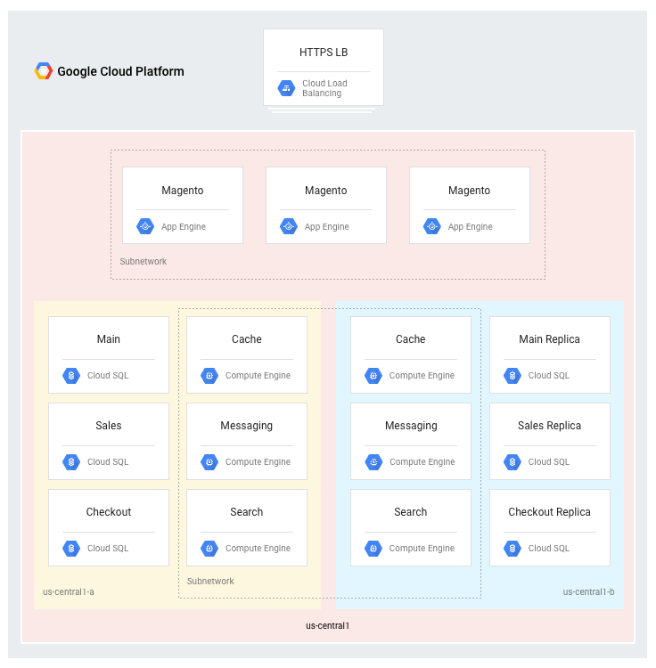
The web application is deployed on the _______ flexible environment.
Load Balancing directs incoming requests to the _______ web application. App Engine automatically provisions ______ as part of the application deployment process.
The cache, search, and messaging components are deployed on _______.
The database component is _______.

Slide 13
Solution
In this architecture, the components are deployed as follows:
The web application is deployed on the App Engine flexible environment.
Load Balancing directs incoming requests to the App Engine web application. App Engine automatically provisions Load Balancing as part of the application deployment process.
The cache, search, and messaging components are deployed on Compute Engine.
The database component is Cloud SQL.

Slide 14
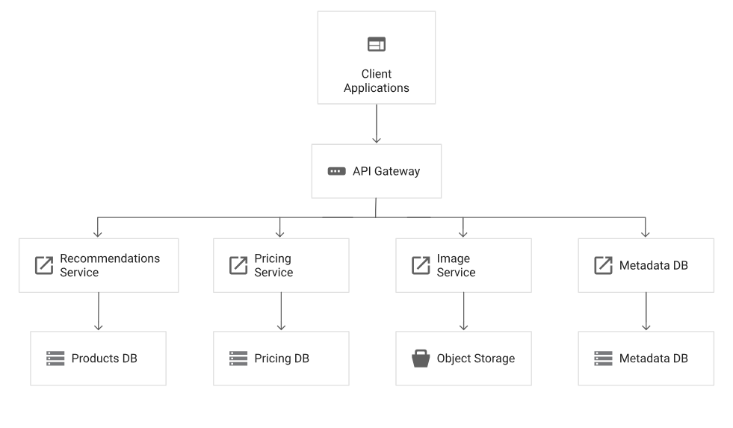
E-commerce

Slide 15
E-commerce

Slide 16
E-commerce

Slide 17
E-commerce

Slide 18
E-commerce

Slide 19
E-commerce

Slide 20
Inventory System

Slide 21
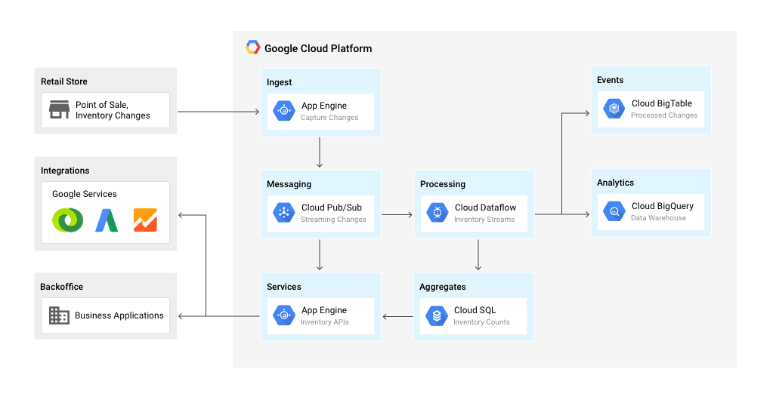

Slide 29
Complex Event Processing

Slide 30
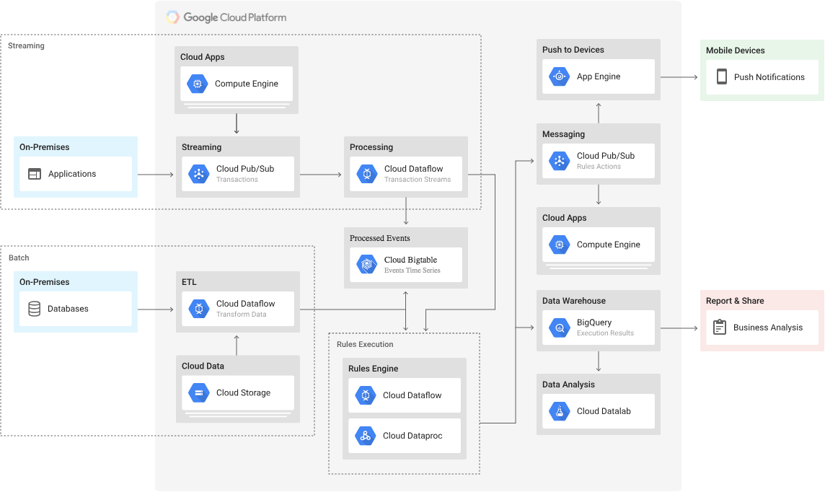

Slide 43
Game Server

Slide 44
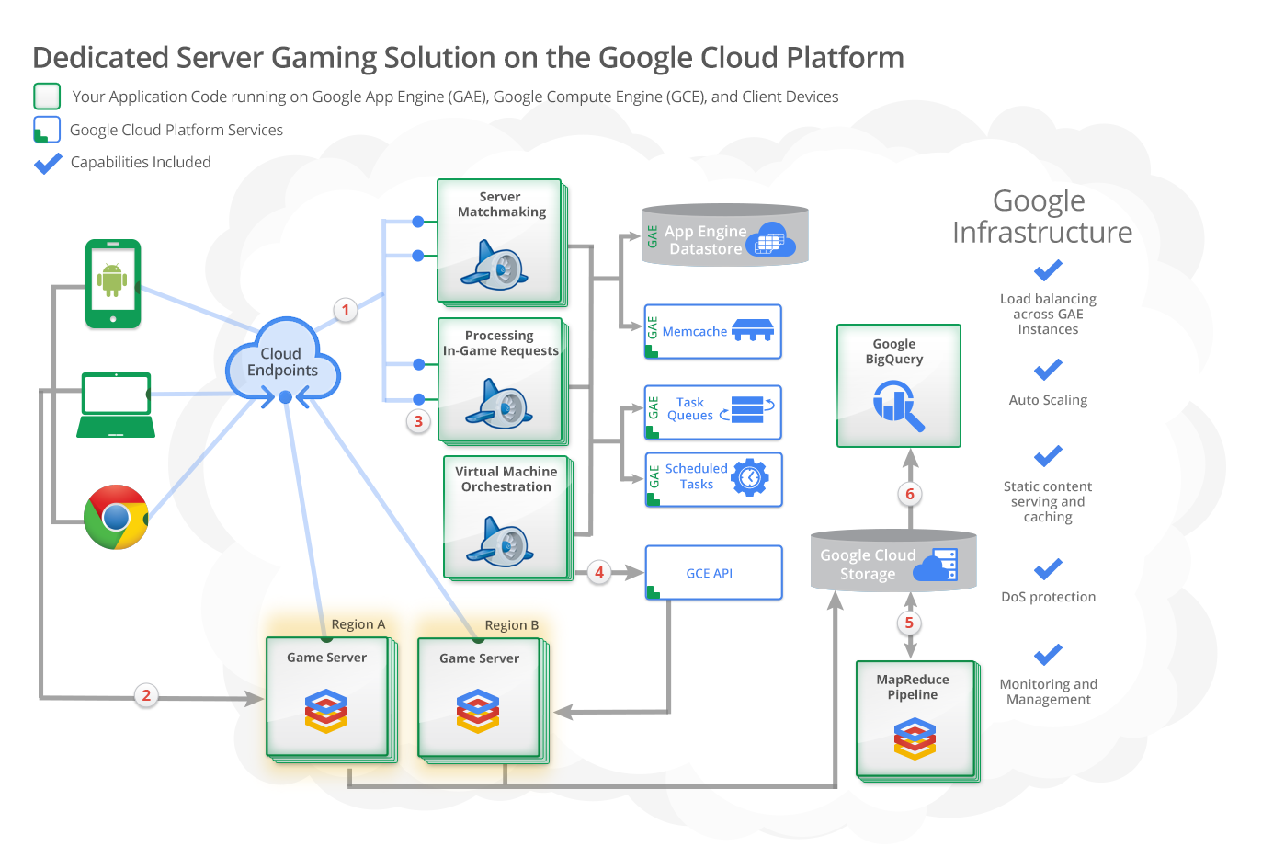

Slide 56
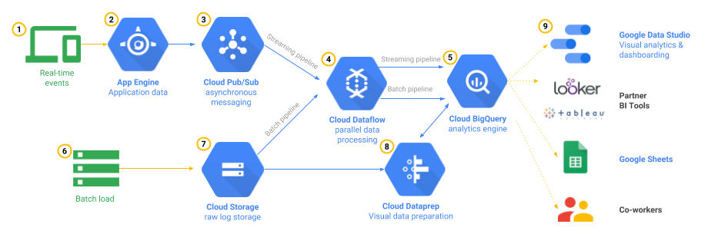
Mobile Game Analytics

Slide 57
Mobile Game Analytics

Slide 58
Mobile Game Analytics

Slide 59
Mobile Game Analytics

Slide 60
Mobile Game Analytics

Slide 61
Mobile Game Analytics

Slide 62
Mobile Game Analytics

Slide 63
IOT

Slide 64
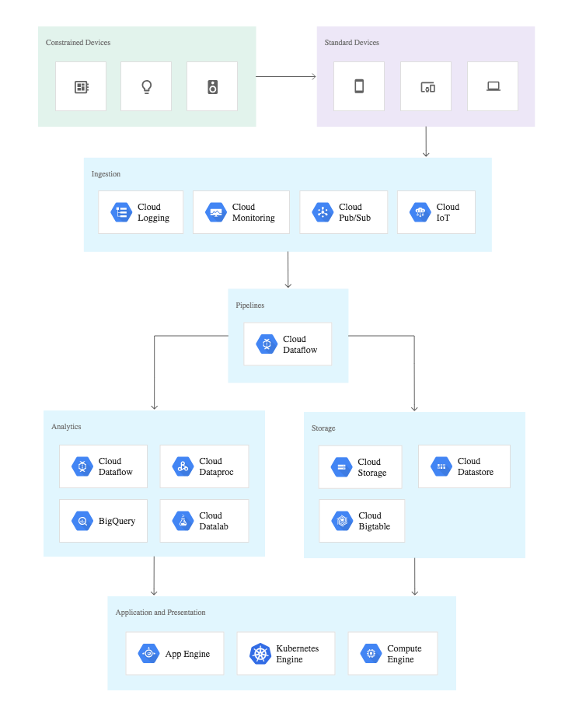
IOT

Slide 65
IOT

Slide 66
IOT

Slide 67
IOT

Slide 68
IOT

Slide 69
IOT

Slide 70
IOT

Slide 71
IOT

Slide 72
IOT

Slide 73
IOT

Slide 74
IOT

Slide 75
IOT

Slide 76
IOT

Slide 77
IOT

Slide 78
IOT

Slide 79
IOT

Slide 80
Global Data Distribution

Slide 81
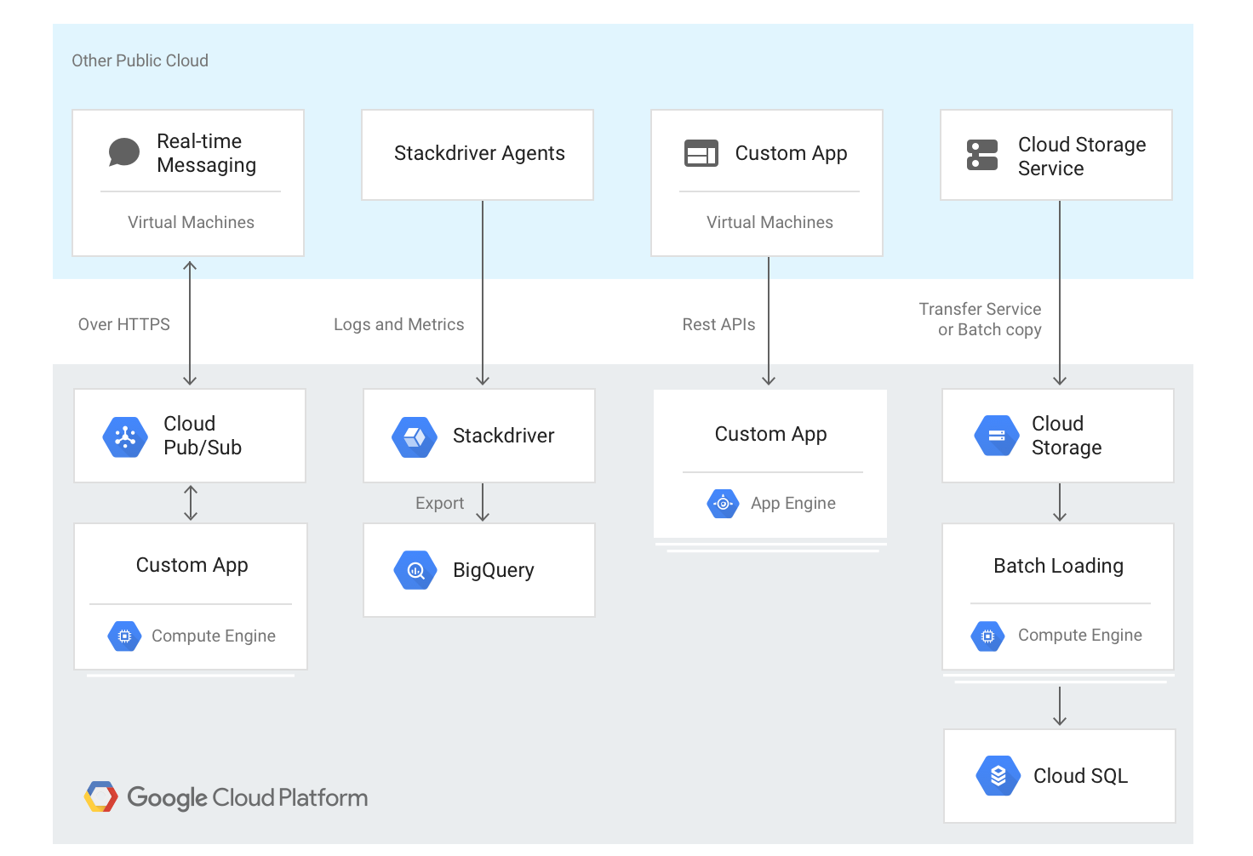
Global Data Distribution

Slide 82
Global Data Distribution

Slide 83
Global Data Distribution

Slide 84
Global Data Distribution

Slide 85
Global Data Distribution

Slide 86
Global Data Distribution

Slide 87
Global Data Distribution

Slide 88
Global Data Distribution

Slide 89
Global Data Distribution

Slide 90
Asset Management

Slide 91
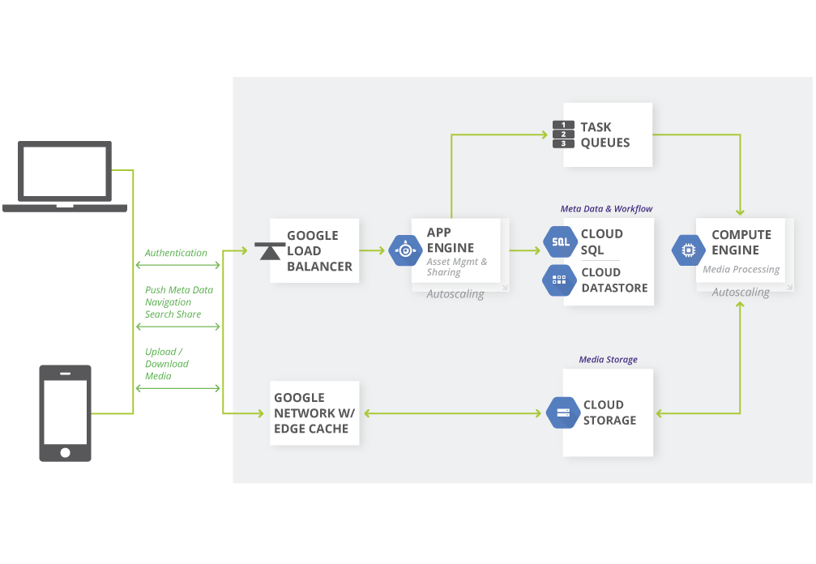
Asset Management

Slide 92
Asset Management

Slide 93
Asset Management

Slide 94
Asset Management

Slide 95
Asset Management

Slide 96
Asset Management

Slide 97
Asset Management

Slide 98
Content Management

Slide 99

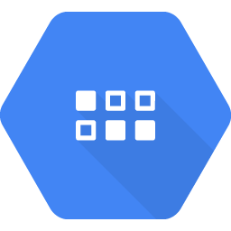



Datastore
Compute engine
SQL
Storage
Big Table

Slide 100
